Slide 1


SAMPLE REPORTS AND MEETING SUPPORT
* Data and insights provided may not be accurate and is for reporting examples only

Slide 2
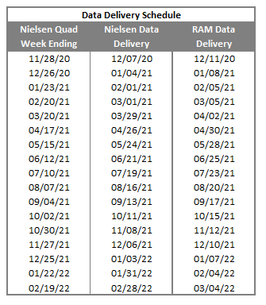
MONTHLY NIELSEN REPORTS
  Monthly reports are delivered every 4 weeks in accordance to the data delivery schedule
  The reports are provided in Excel format via email or data sharing portal
  The 3 provided reports:
    Rankings Report (5 tabs)
      Item
      Brand
      Supplier
      Varietal
      Price Tier
    Category Review (4 tabs)
      Overview
      Varietal Summary
      Price Tier Summary
      Prioritized Items
    Executive Summary (1 tab)

Slide 3
RANKING REPORT
Ranking Report Summary
  The Ranking Report is the most granular report offered by RAM Analytics This report is the Nielsen raw data organized into an easy to read, user-friendly format. The Ranking Report includes all items in the category and can be filtered to answer many different business questions about performance of your business, the competitive set, and your customer’s business.
    Best Uses of the Ranking Report
  Health of business at the item, brand, varietal, or price tier level (your business, your competitor, or your customer)
  Changes in business performance over time
  Benchmarking against other items or suppliers
  Distribution loss or gains targeted down to items
  This report includes your top markets and can filtered to display different time periods, suppliers, brands, varietals, markets, country of origin, price tier, and package side.

Slide 4
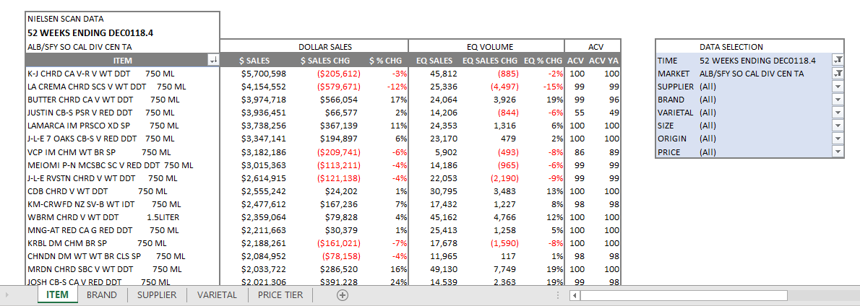
RANKING REPORT
Item Tab
The Ranking Report Includes
  9 Liter equivalent sales actual change vs YA
  9 Liter equivalent sales % change
  All commodity volume
  All commodity volume YA
  $ Sales
  $ Sales actual change vs year ago
  $ Sales % change
  9 Liter equivalent sales

Slide 5
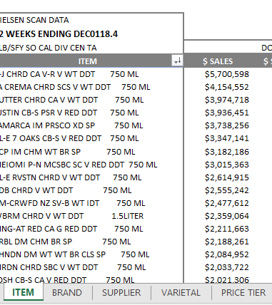
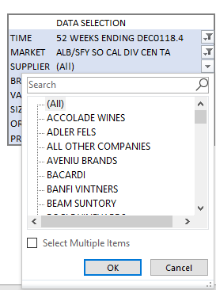
RANKING REPORT
Available Data Selections
Available Summary Tabs
  Use the search boxes to easily find and filter for desired data
  The report includes 5 different tabs to provide a quick data summary
    Item
    Brand
    Supplier
    Varietal
    Price Tier
  Time (L4W, L13W, L26W, L52W)
  Market
  Supplier
  Brand
  Size
  Country of Origin
  Price Tier
  Varietal

Slide 6
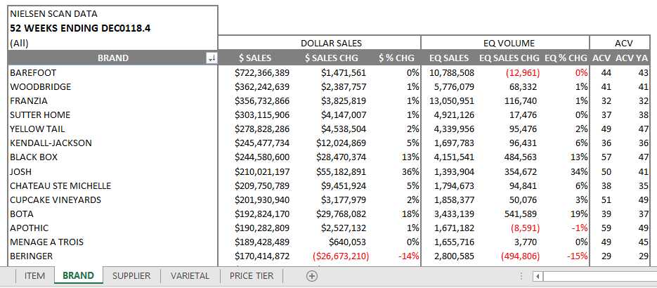
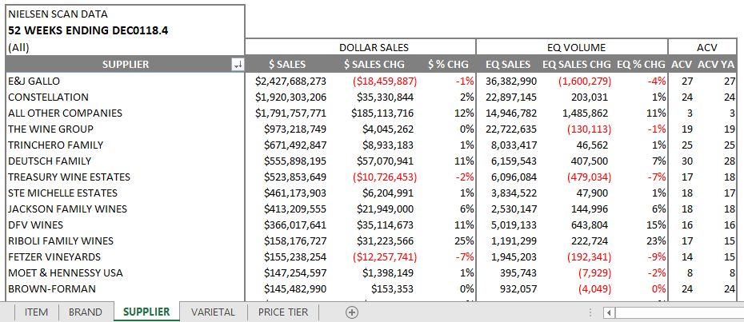
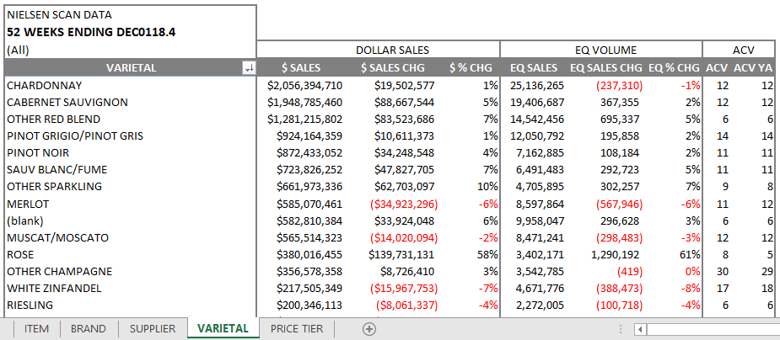
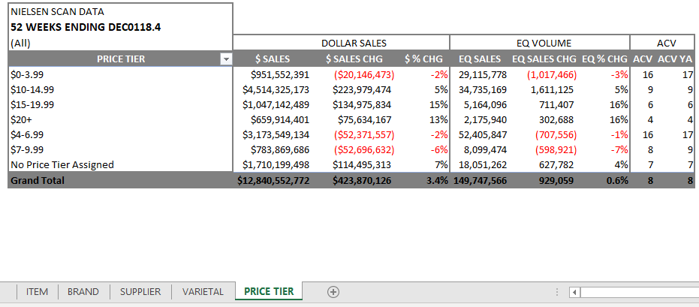
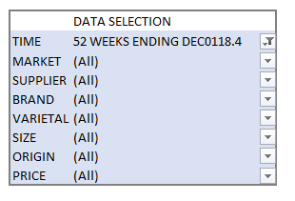
RANKING REPORT
Brand Tab
Supplier Tab
Varietal Tab
Price Tier Tab
All tabs include the search box options
All tabs include a subtotal at the bottom

Slide 7
CATEGORY REVIEW
The Category Review Overview
  The Category Review is a way to analyze the performance of a category and expose opportunity for your products. This tool can be used to give retailers suggestion on how the categories and overall business performance can be improved. The Category Review can be drilled down to many different levels to display a topline or granular review of a category.
    Best Uses of the Category Review Reports
  Index of a category by varietal, price tier, or both
  Dollar opportunity of a category by varietal, price tier, or both
  Health of a category vs rest of market
  Gap to competitive market
  This report includes your top 20 markets and can filtered to display different time periods, markets and rest of markets, and package side.

Slide 8
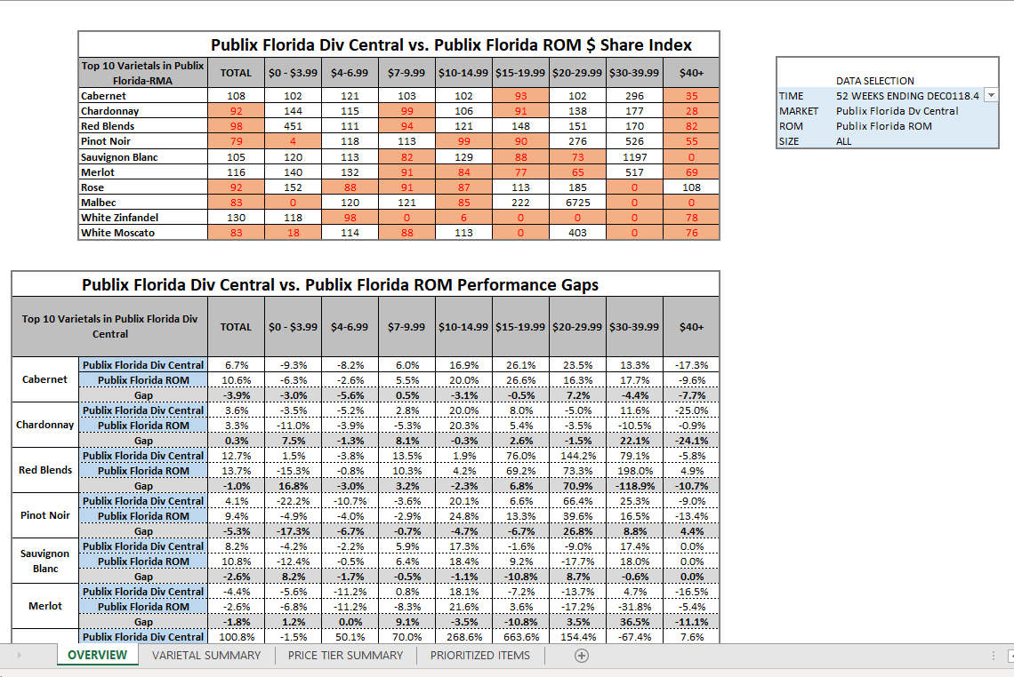
CATEGORY REVIEW
Overview Tab
  Use the overview tab to get a snapshot of the varietal/price tier index or performance gaps to rest of market

Slide 9
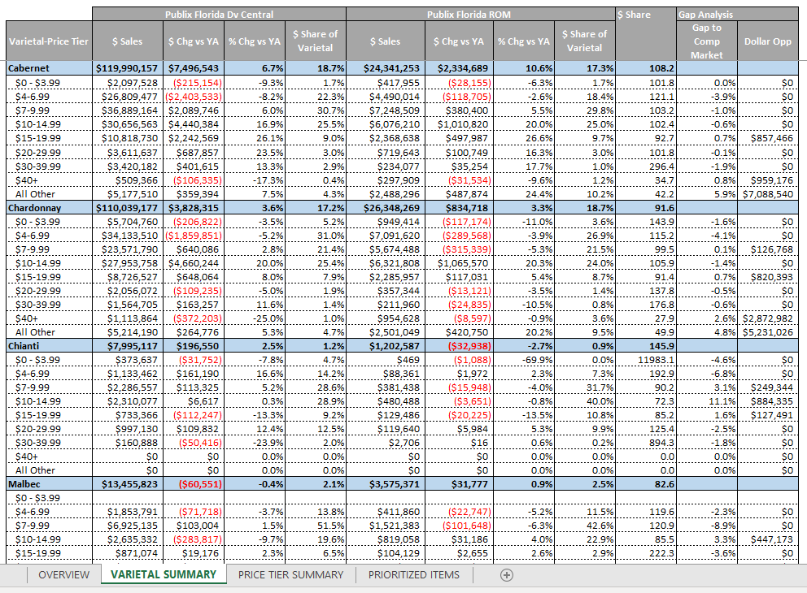
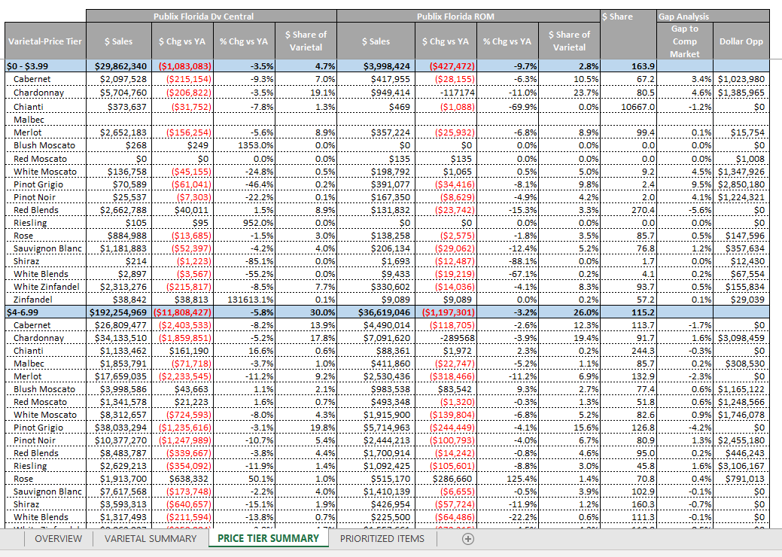
CATEGORY REVIEW
Varietal Summary Tab
Price Tier Summary Tab
  Use the varietal summary tab to deep dive into category opportunities
  Investigate the categories by price tier summary or varietal summary

Slide 10
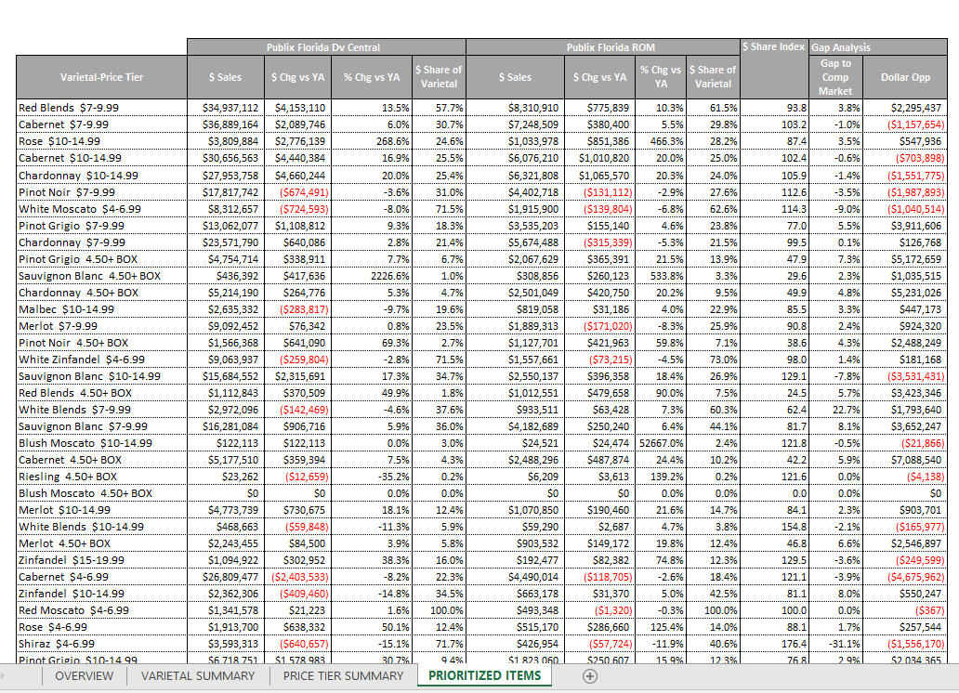
CATEGORY REVIEW
Prioritized Items Tab
 | DATA SELECTION
TIME | 52 WEEKS ENDING DEC0118.4
MARKET | Publix Florida Div Central
ROM | Publix Florida ROM
SIZE | ALL
Available Data Selections
  Use the search boxes to easily find and filter for desired data
  Time (L4W, L13W, L26W, L52W)
  Market
  Rest of Market
  Package Size
  Use the prioritized items tab to gain an immediate understanding on what categories present the most opportunity

Slide 11
EXECUTIVE SUMMARY
The Executive Summary Overview
  The Executive Summary is a brief overview of your business in multiple accounts. It provides a summarized version of the Item Ranking report. The Executive Summary is most useful for users to rapidly become acquainted with the business without having to dig into granular data.
    Best Uses of the Executive Summary Report
  Health of business in each account
  Distribution gains and losses by account
  Price integrity of products
  This report includes your top 20 markets and can filtered to display different time periods, brands, size, country of origin, price tier, or varietal.

Slide 12
EXECUTIVE SUMMARY
Available Data Selections
  Use the search boxes to easily find and filter for desired data
  Time (L4W, L13W, L26W, L52W)
  Brand
  Size
  Country of Origin
  Price Tier
  Varietal
The Executive Summary Includes
  Select up to 20 different markets
  $ Sales actual change vs year ago
  $ Sales % change
  9 Liter equivalent sales
  9 Liter equivalent sales actual change vs YA
  9 Liter equivalent sales % change
  All commodity volume
  All commodity volume % change vs YA
  Average retail price
  Average retail price actual change vs YA

